Slide 1
Week 5 Class 1:
Models
INST408C: Cognitive Security | Fall 2021 | SJ Terp

Slide 2
Week 5
Monday
Frameworks for understanding cognitive security
Layer-based models
Object-based models
Behaviour-based models
Introduces students to infosec-related models of information operations and disinformation, with examples of their use and connection to other information security practices.
Outcome: students will be able to evaluate disinformation incidents and their components.
Wednesday
Relationship models
Graphs
Groups
Readings
Pamment’s ABCDE paper
Assignments

Slide 3
What’s a Framework? What’s a model?

Slide 4
Framework vs Model
Model - a representation. Examples include physical and conceptual models
Framework - structure underlying a concept, system etc.

Slide 5
Models

Slide 6
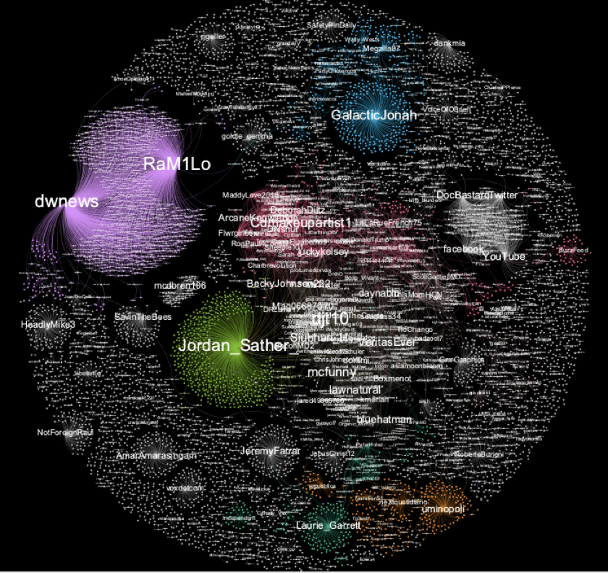
Simple model: social media influence

Slide 7
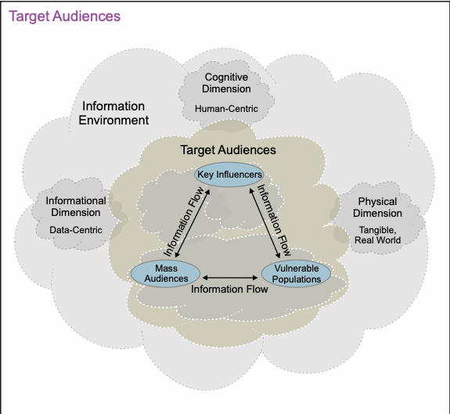
Audience models: JP3-13
Notes:
https://www.jcs.mil/Portals/36/Documents/Doctrine/pubs/jp3_13.pdf

Slide 8
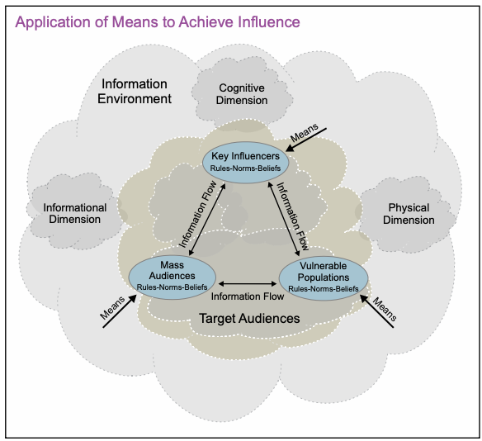
Means (what)

Slide 9
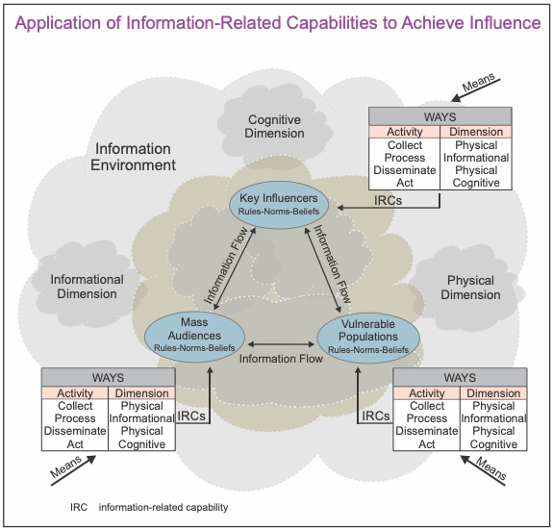
Ways (how)

Slide 10
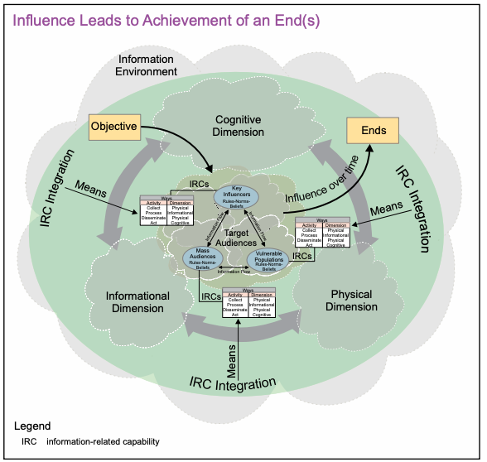
Ends (why)

Slide 11
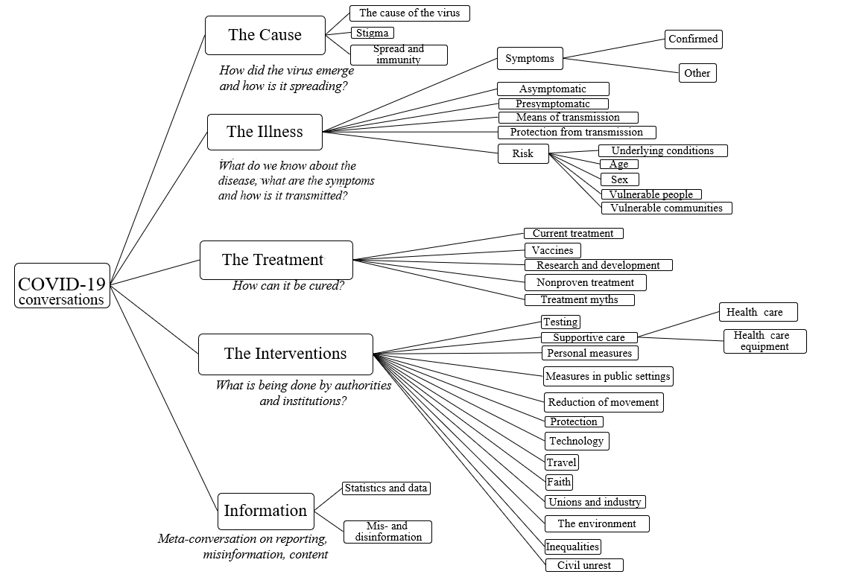
WHO Covid19 Narratives Model

Slide 12
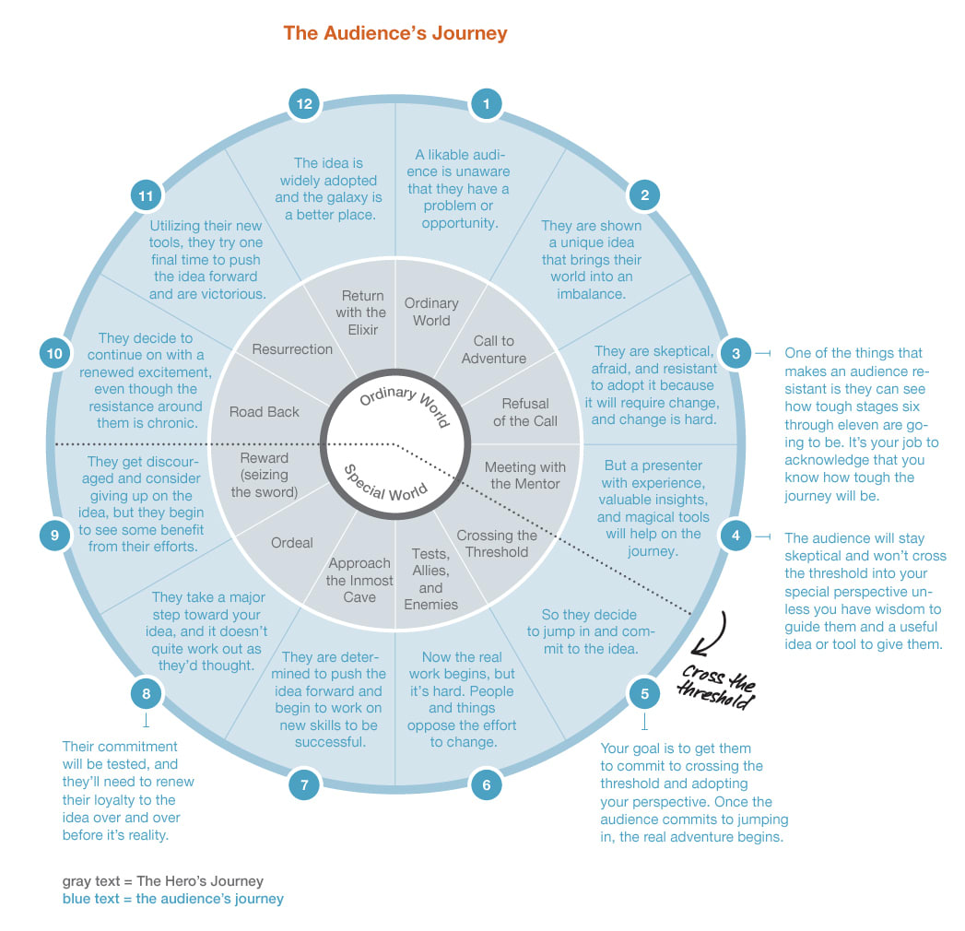
Storytelling framework: the hero’s journey
Notes:
Image: https://www.peterfisk.com/2020/02/the-best-storytelling-frameworks-for-business-from-pyramid-thinking-to-the-heros-journey-steve-jobs-iphone-speech-and-mlks-i-have-a-dream/

Slide 13
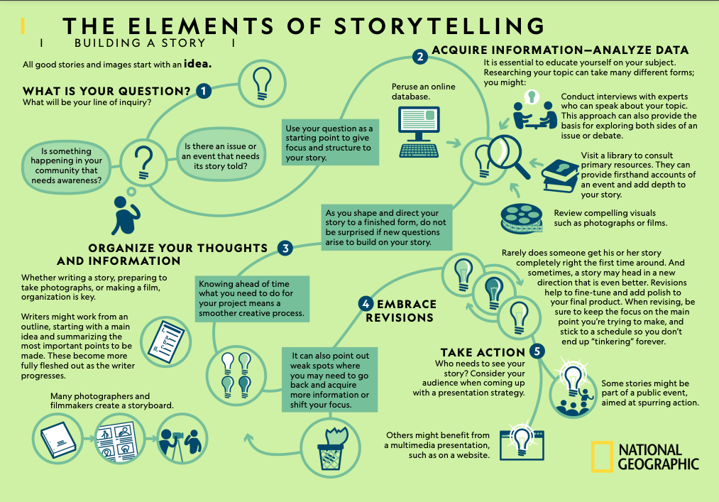
Storytelling framework: story journey
Notes:
https://www.nationalgeographic.org/media/elements-storytelling/

Slide 14
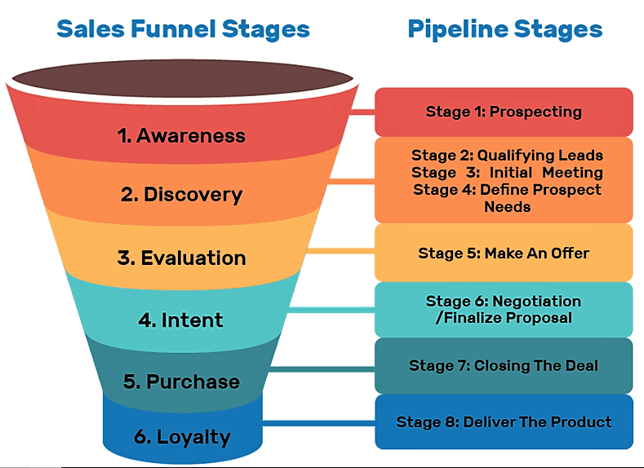
Sales funnels are stories too
Image: https://suzanneperkinsm.medium.com/what-is-a-sales-funnel-and-why-websites-dont-work-anymore-1450fc99e69b
Notes:
A sales funnel shows the stages that someone goes through, from being aware of a product to buying it
Links:
https://suzanneperkinsm.medium.com/what-is-a-sales-funnel-and-why-websites-dont-work-anymore-1450fc99e69b

Slide 15
Layer based models:
setting levels

Slide 16
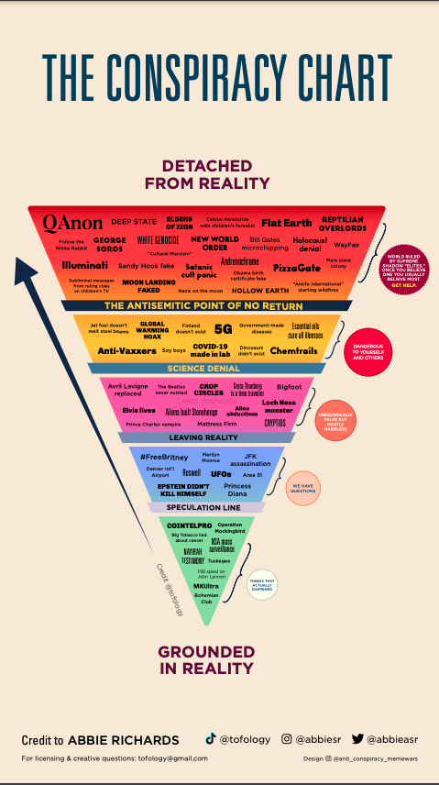
The conspiracy chart
Notes:
Links:
https://drive.google.com/file/d/1QYfof919nxaO73hrhTvDsafD_egyF5Wg/view

Slide 17
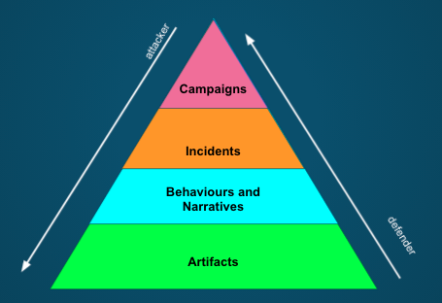
Disinformation pyramid

Slide 18
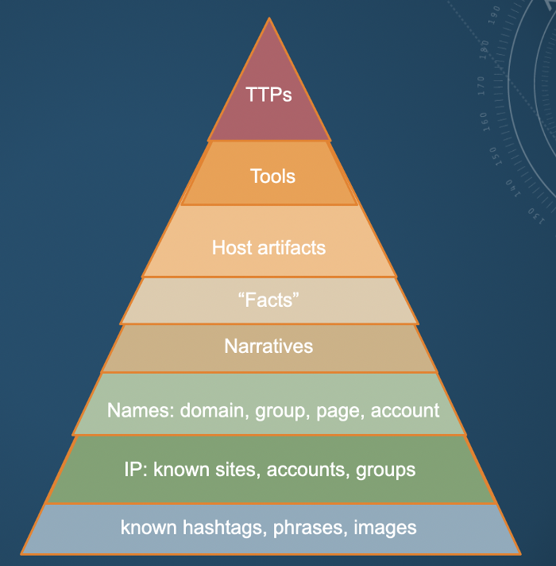
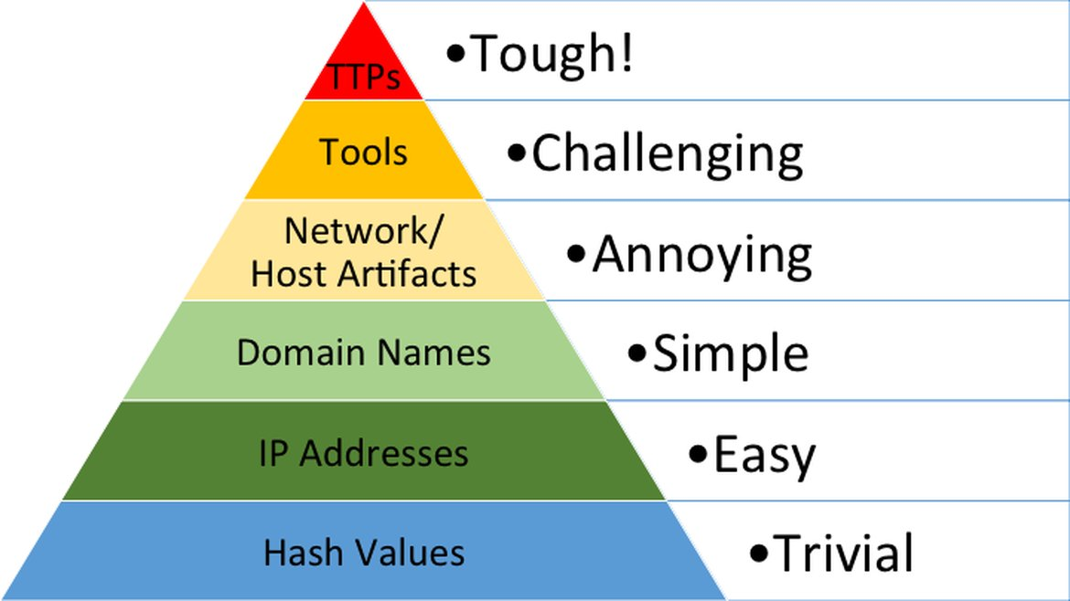
Pyramids of pain
Notes:
https://sarajayneterp.medium.com/cognitive-security-pyramid-of-pain-3f0f860e86cd

Slide 19
Object based frameworks:
Modelling disinformation ecosystems

Slide 20
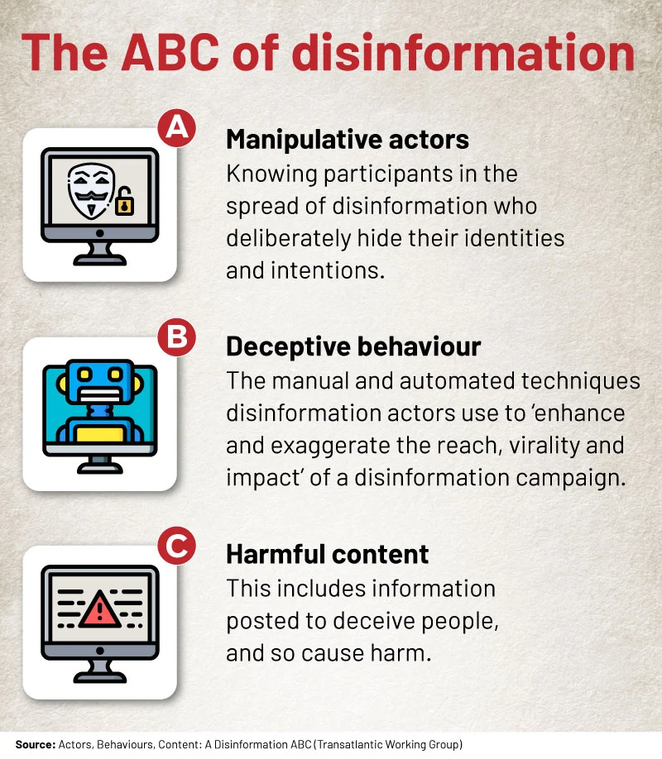
ABC (Francois)
Notes:
ABC from https://africacheck.org/fact-checks/reports/anatomy-disinformation-campaign-who-what-and-why-deliberate-falsehoods-twitter

Slide 21
ABCDE (Pamment)
Actor | What kinds of actors are involved? This question can help establish, for example, whether the case involves a foreign state actor
Behavior | What activities are exhibited? This inquiry can help establish, for instance, evidence of coordination and inauthenticity
Content | What kinds of content are being created and distributed? This line of questioning can help establish, for example, whether the information being deployed is deceptive.
Degree | What is the overall impact of the case and whom does it affect? This question can help establish the actual harms and severity of the case.
Effect | What is the overall impact of the case and whom does it affect? This question can help establish the actual harms and severity of the case.
Notes:
https://carnegieendowment.org/2020/09/24/eu-s-role-in-fighting-disinformation-crafting-disinformation-framework-pub-82720

Slide 22
Actor
which kinds of actors produce and engage with the suspected disinformation
Individual(s): Is the person involved acting in his or her private capacity?
Nonstate actor(s): Is the actor affiliated with a private or nongovernmental organization?
Media platform(s): To what degree is the platform of distribution independent?
Political actor(s): Does the individual act on behalf of a recognized political entity?
Foreign state(s): Is the actor an agent or proxy of a foreign government?

Slide 23
Behaviour
to what extent deception or other illegitimate communication techniques are part of the case
Transparency: Is the actor disguising his or her identity or actions?
Dependency: Is the individual acting on behalf of another party?
Authenticity: Is the actor using illegitimate communication techniques?
Infrastructure: Is there evidence of back-end coordination?
Intent: Does the behavior suggest a malign intent?

Slide 24
Content
information that is used in the case
Truthfulness: Is the content verifiably untrue or deceptive?
Narrative(s): Does the content align with known disinformation narratives?
Language(s): Which languages are used in the spread of the disinformation or other online content in question?
Synthetic: Is the content manipulated or artificial?
Expression: Is the content reasonable self-expression protected by fundamental freedoms?
Harm: Is the content harmful?

Slide 25
Degree
information related to the distribution of the content in question and the audiences it reaches in a particular case
Audience(s): Who constitutes the content’s main target audience(s)?
Platform(s): Is it possible to map which channels or platform(s) are used to distribute the content and how they interact?
Virility: Is the content going viral on social media platforms in a way that would suggest an inauthentic boost to online engagement?
Targeting: Is the content tailored or microtargeted, and, if so, to which audiences?
Scale: Does the scale indicate a single operation or an ongoing campaign?

Slide 26
Effect
indicators of impact to understand how much of a threat a given case poses
Climate of debate: Is the online content issue-based? Does it, for example, involve false information, polarization, or trolling?
Trust/reputation: Is the content target-based? Does it, for example, involve false rumors, cybersecurity hacks, forgeries and/or media leaks?
Fundamental freedoms: Is the content denying a fundamental freedom? For example, does it seek to deny freedom of expression or of political deliberation?
Public health: Does the content threaten individuals’ health, physical wellbeing, or medical safety?
Public safety: Does the content threaten individuals’ physical wellbeing or public order?
Election integrity: Does the content dissuade voters from participating in elections or seek to undermine the results of an election?
National security: Does the content threaten the territorial integrity or the national security of a sovereign state?

Slide 27
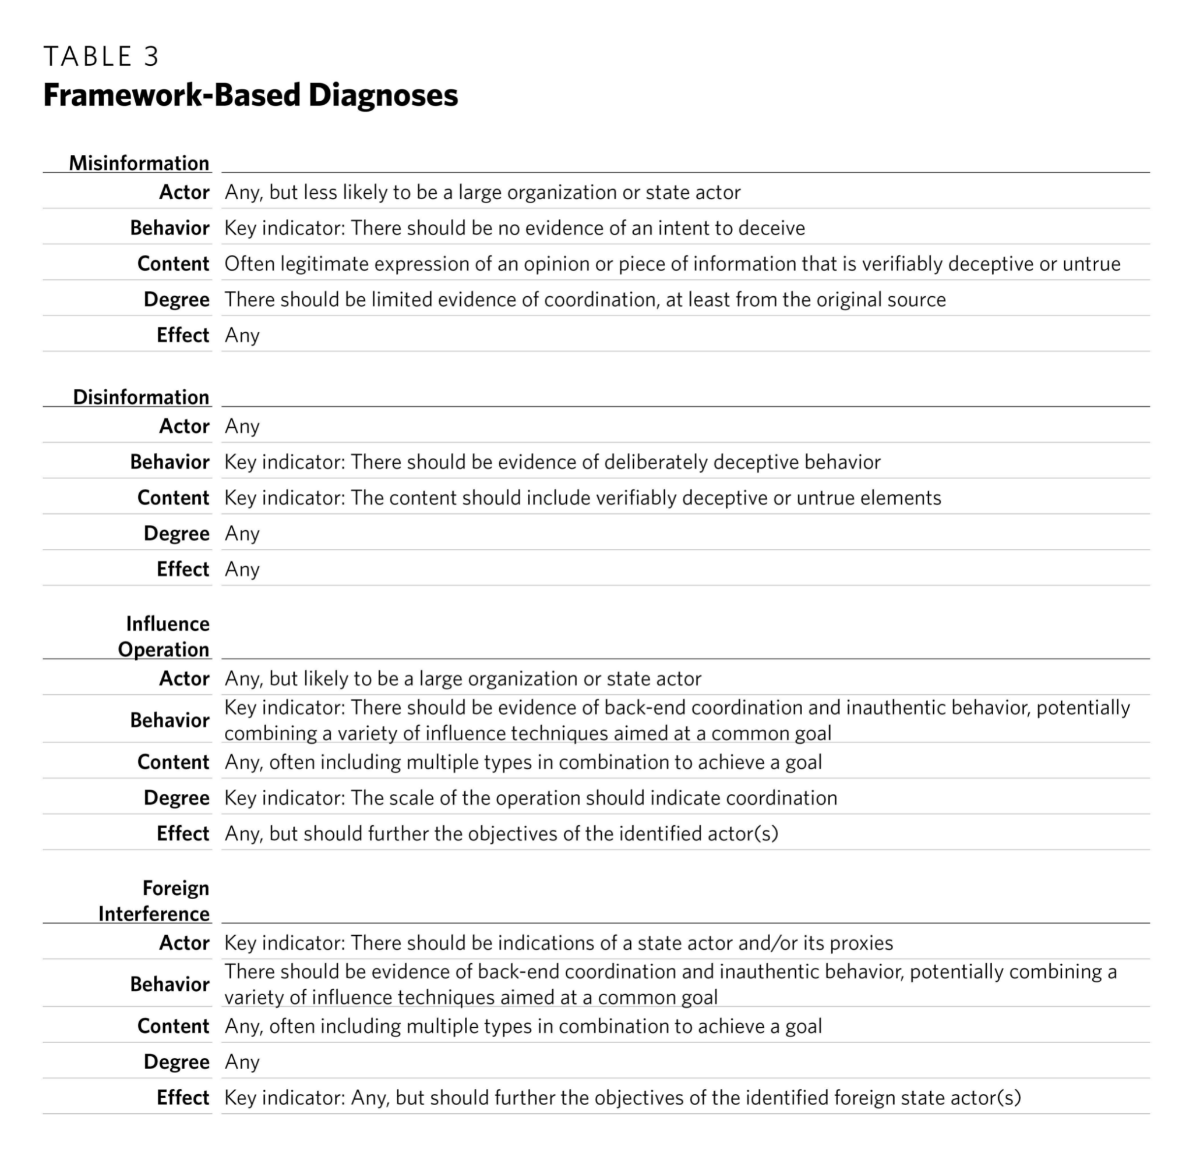
ABCDE use: determining which type of activity

Slide 28
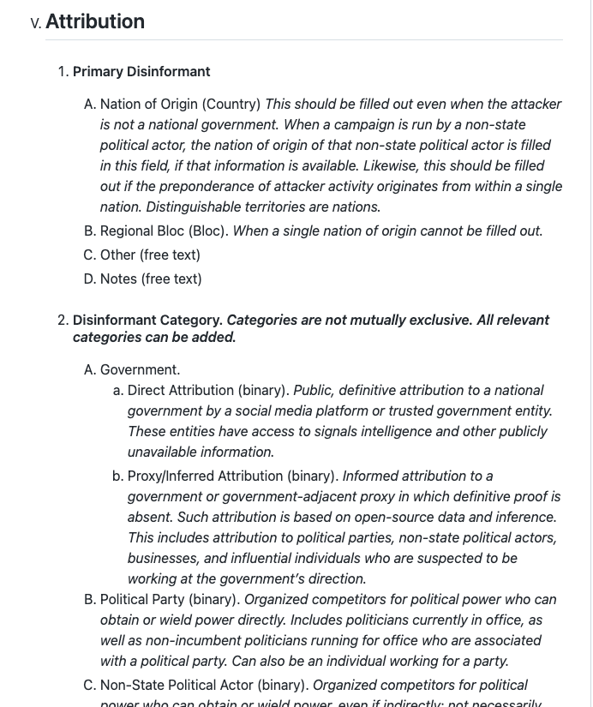
DFRLab Dichotomies of Disinformation
Target describes the national or supranational characteristics of the target, to include its political or social strata.
Platform describes the medium through which the disinformation is conveyed, to include open web, social media, and messaging services.
Content describes the language and topic of the disinformation.
Methods describes the tactics and narrative techniques that are used to disseminate the disinformation.
Attribution describes the national or supranational characteristics of the disinformant, to include its political or social strata, as well as the confidence of the attribution.
Intent describes the inferred purpose of the political disinformation campaign.
Notes:
Designed for political disinformation.
Links:
https://github.com/DFRLab/Dichotomies-of-Disinformation

Slide 29
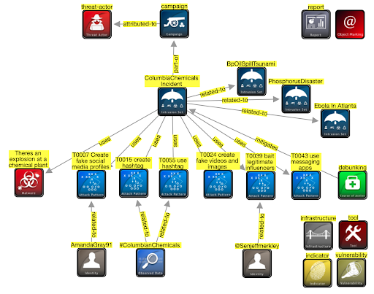
AMITT STIX

Slide 30
Disinformation behaviour
models and frameworks

Slide 31
4D Model of disinformation campaigns (Nimmo)
Dismiss: if you don’t like what your critics say, insult them.
Distort: if you don’t like the facts, twist them.
Distract: if you’re accused of something, accuse someone else of the same thing.
Dismay: if you don’t like what someone else is planning, try to scare them off.
Notes:
https://online.umich.edu/teach-outs/disinformation-misinformation-and-fake-news-teach-out/lessons/4d-model-disinformation-campaigns/

Slide 32
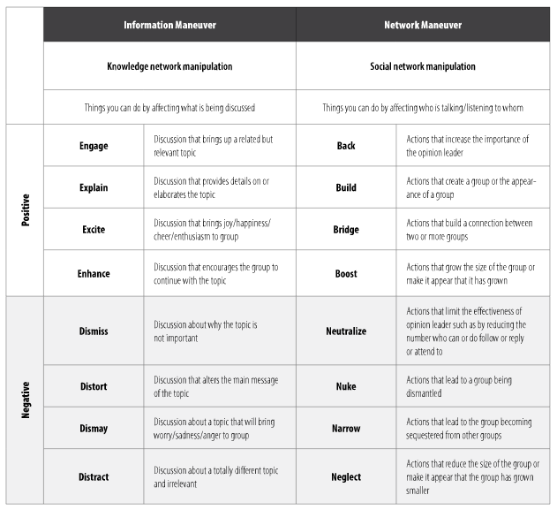
BEND (Carley)
Notes:
https://www.armyupress.army.mil/Journals/Military-Review/English-Edition-Archives/Mar-Apr-2019/117-Cybersecurity/b/

Slide 33
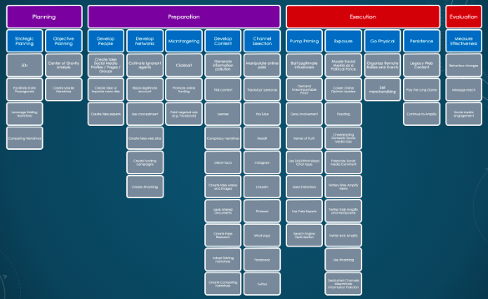
AMITT Red Framework
Notes:
SJ Terp et al
https://github.com/cogsec-collaborative/AMITT

Slide 34
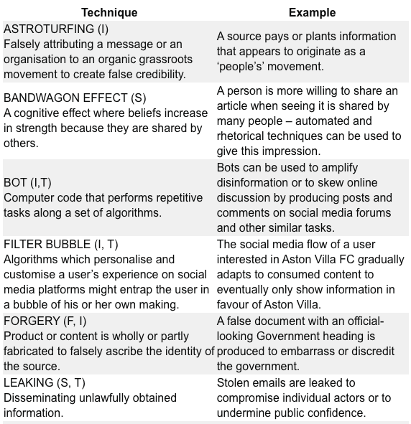
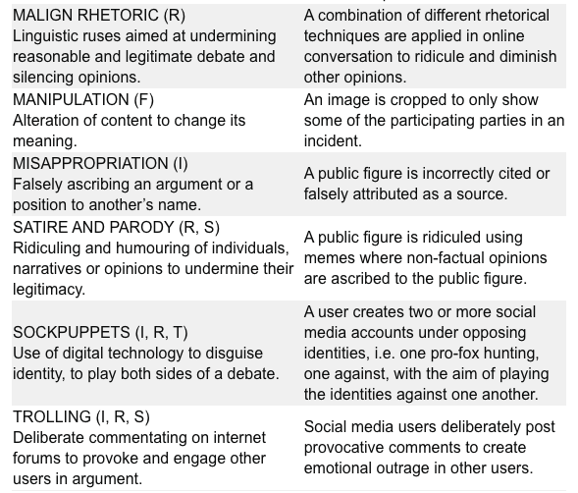
RESIST Behaviours models
Notes:
https://gcs.civilservice.gov.uk/publications/resist-counter-disinformation-toolkit/

Slide 35
Risk models and frameworks

Slide 36
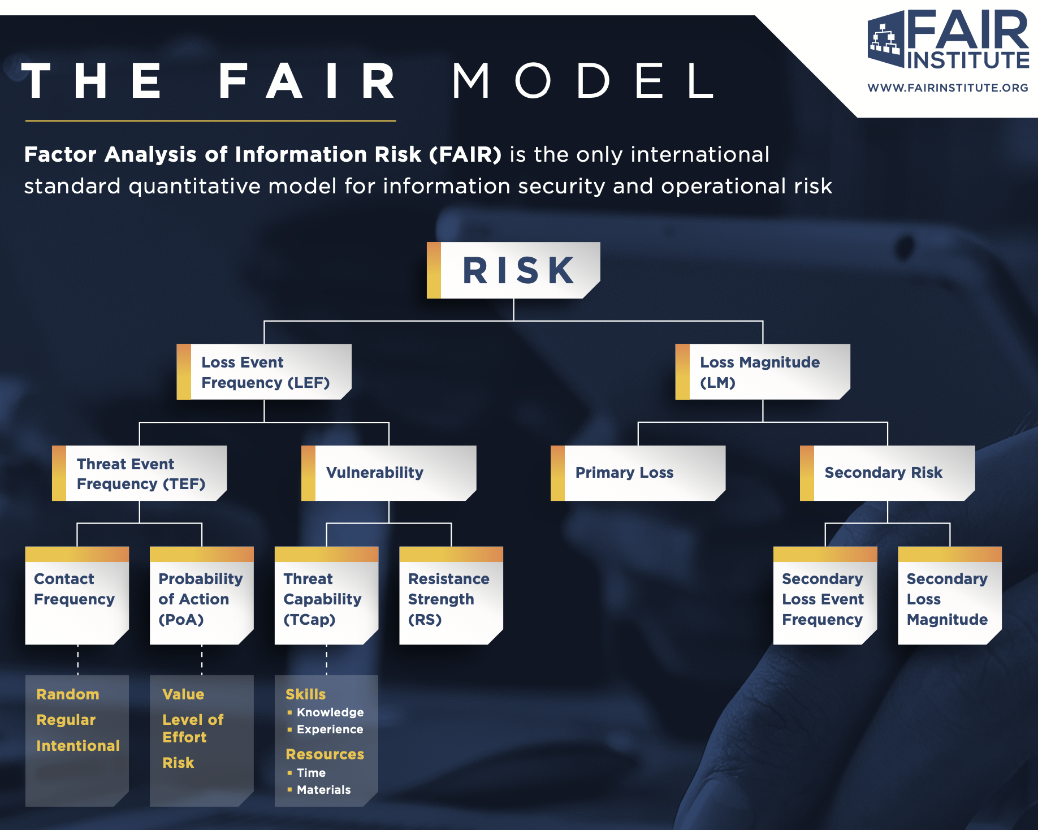
Notes:
Image: the FAIR model on one page

Slide 37
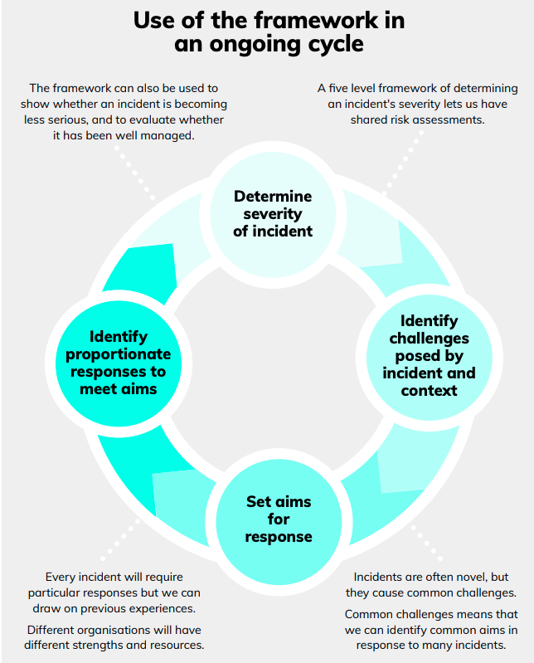
FullFact risk-levels framework
Business as normal, no additional response needed
Monitor and prepare external facing responses
An incident is occurring, responses ramp up
An incident is occurring, coordinated responses start
Maximum response levels and cooperation required
Notes:
https://fullfact.org/media/uploads/framework-information-incidents-consulation.pdf

Slide 38
Response behaviour
models and frameworks

Slide 39
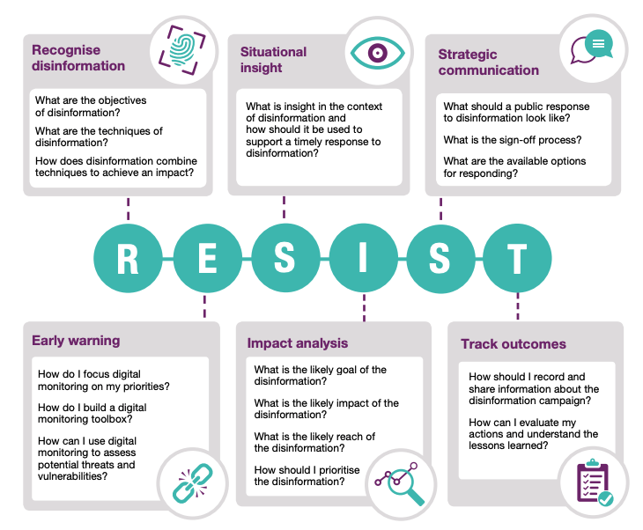
RESIST Framework

Slide 40
AMITT Blue
Planning
Preparation
Execution
Evaluation
Strategic Planning
Objective Planning
Develop People
Develop Networks
Microtargeting
Develop Content
Channel Selection
Pump Priming
Exposure
Go Physical
Persistence
Measure Effectiveness
Have a disinformation response plan
Media literacy through games
Find and train influencers
Remove old and unused accounts
Fill information voids
Hijack content and link to information
Rate-limit engagement
Microtarget likely targets with counter messages
Prebunking
DMCA takedown requests
Poison monitoring and evaluation data
Improve stakeholder coordination
Tabletop simulations
Counter-social engineering training
Unravel Potemkin villages
Stem flow of advertising money
Honeypot social community
Redirect searches away from disinfo
Train journalists to counter influence moves
Humorous counter narratives
Spam domestic actors with lawsuits
Bomb link shorteners with calls
Make civil society more vibrant
Make information provenance available
Ban incident actors from funding sites
Verify project before posting fund requests
Buy more advertising than disinformation creators
Corporate research funding full disclosure
Honeypot: fake engagement system
Tool transparency and literacy in followed channels
Mark content with ridicule / decelerants
Seize and analyse botnet servers
Add random links to network graphs
Red team disinformation, design mitigations
Block access to disinformation resources
Address truth in narratives
Encourage people to leave social media
Reduce political targeting
Real-time updates to factcheck database
Bot to engage and distract trolls
Ask media not to report false info
Expire social media likes/ retweets
Enhanced privacy regulation for social media
Educate influencers
Marginalise and discredit extremist groups
Deplatform message groups and boards
Co-opt disinformation hashtags
Remove non-relevant content from special interest groups
Strengthen verification methods
Repurpose images with counter messages
Influencer disavows misinfo
Platform regulation
Buy out troll farm employees / offer jobs
Ensure platforms are taking down accounts
Stop offering press credentials to disinformation outlets
Mentorship: elders, youth, credit
Content moderation
Verified ids to comment or contribute to poll
Engage payload and debunk
Cut off banking access
Shared fact checking database
Legal action against for-profit engagement farms
Name and shame disinformation influencers
Free open library sources
Prohibit images in political Chanels
Revoke whitelist / verified status
Debunk/ defuse fake expert credentials
Dampen emotional reaction
Repair broken social connections
Develop compelling counter narratives
Denigrate funding recipient / project
Social media source removal
Add metadata to original content
Don’t engage with payloads
Remove / rate limit botnets
Pre-emptive action against disinformation team infrastructure
Run competing campaigns
Infiltrate in-groups
Infiltrate disinformation platforms
Add warning labels on sharing
Hashtag jacking
Social media amber alert
Etc
Etc
Etc
Etc
Etc
Etc
Etc
Notes:
This is the AMITT Blue framework: it contains 160 countermoves to the campaign and incident techniques that we analysed with AMITT Red. We used information operations frameworks to create this, specifically the classifications Deny, Disrupt:, Degrade, Deceive:, Destroy, and Deter - for each tactic stage and Red technique.
We’ve partnered with counter-disinformation groups like RealityTeam.org who use targeted counter messaging and metrics to push away disinformation narratives. And we’re currently cleaning this matrix up.

Slide 41
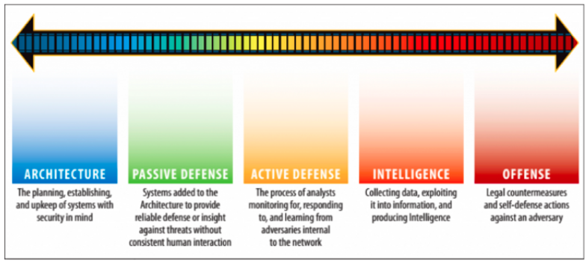
Other ways to slide activities

Slide 42
Lifecycle models

Slide 43
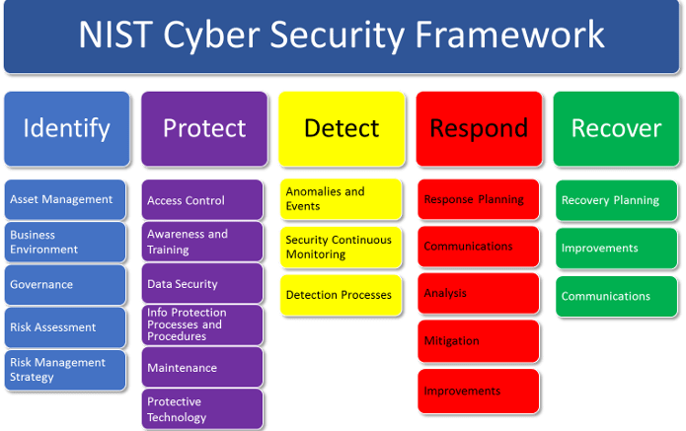
NIST
Notes:
We’ve seen this one before. This one is all about you.

Slide 44
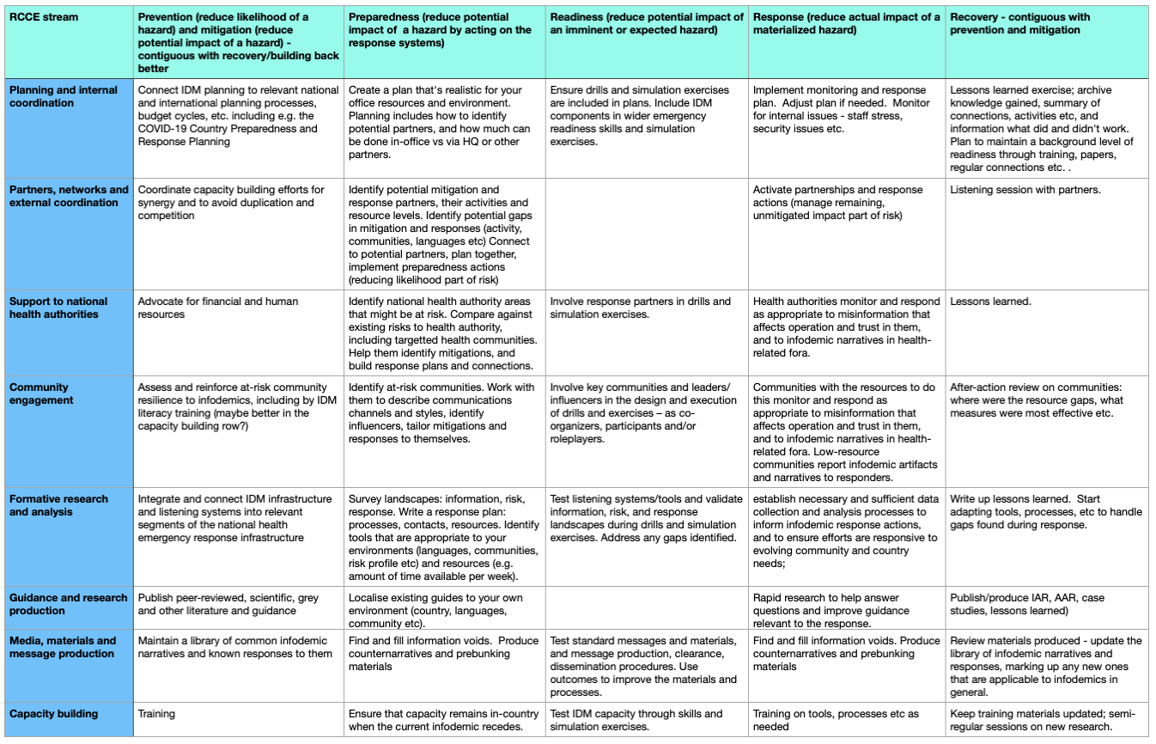
Notes:
WHO response model

